Slide 1
Quick Test Professional
Mercury
Functional - Regression Testing tool
Author – Priya Mukunthan

Slide 2
WHY WE GO FOR AUTOMATION
Manually testing software is a time-consuming and often tedious process
Cannot guarantee coverage consistency of testing across releases and across platforms
Time constraints often do not afford us the luxury of being able to manually test and retest our applications before they are released
When we want to execute the application, same operation with multiple sets of data
Regression and confirmation. Rerunning a test against a new release to ensure that behavior remains unbroken—or to confirm that a bug fix did indeed fix the underlying problem—is a perfect fit for automated testing.

Slide 3
AUTOMATED TESTING
Automating your testing leads to a better use of your resources.
Skilled testers are freed up to put more effort into designing better tests while machines that would otherwise lie idle overnight can be used to run unattended automated tests.
Large Product applications.

Slide 4
BENEFITS OF AUTOMATION
Providing more coverage of regression testing.
Reducing the elapsed time for testing, getting your product to market faster.
Improving productivity of human testing.
Improving the re-usability of tests.
Providing a detailed test log.

Slide 5
INTRODUCTION TO QTP
Mercury QuickTest Professional provides the industry’s best solution for functional test and regression test automation - addressing every major software application and environment.
In QuickTest, test scripts are composed of statements coded in Microsoft's programming language - VBScript

Slide 6
About QTP
  QuickTest Professional enables you to test
  Note:
  Add-ins for special environments such as Java, Oracle, SAP solutions, .NET Windows and Web Forms, Siebel, PeopleSoft, Web services, and Terminal emulator applications.
  Standard Windows applications
  Web objects, ActiveX controls
  Visual Basic applications and
  Multimedia objects on Web pages.

Slide 7
Versions Of QTP
QTP 9.0
QTP 8.2
QTP 8.1
QTP 8.0
QTP 6.5
QTP 6.0
QTP 5.6

Slide 8
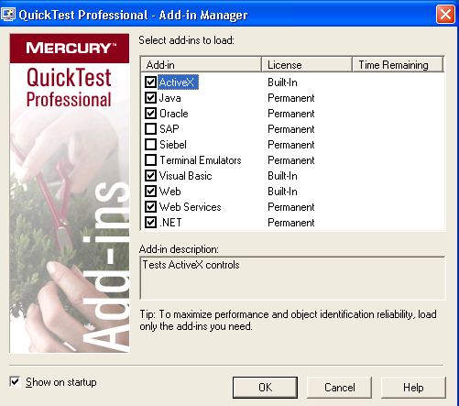
Add-in Manager

Slide 9
QUICKTEST WINDOWS
Keyword View:
  Enables to create and view the steps of the test in a keyword-driven.
  Table-like view, in which each step is a separate row in the table, and each column represents different parts of the steps.
Expert View:
  Enables to create scripts in the form of VBscript for each operation performed on the application.
  Script editor and for each object and method in an Expert View statement, a corresponding row exists in the Keyword View

Slide 10
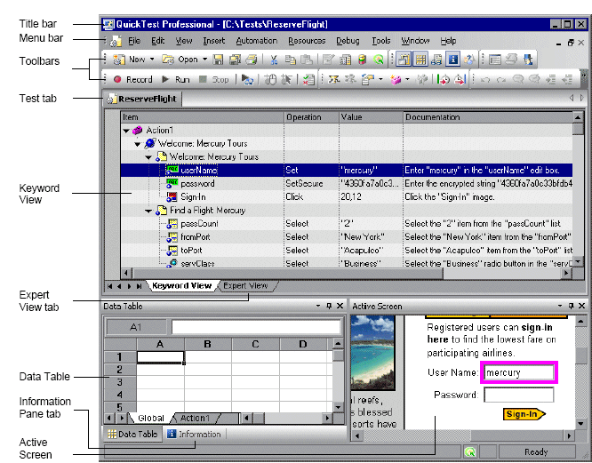
KEYWORD VIEW

Slide 11
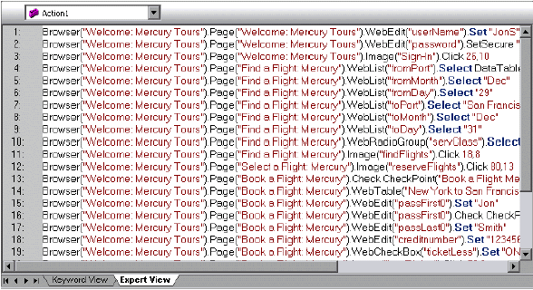
EXPERT VIEW

Slide 12
Quick Test Professional
Testing Process

Slide 13
Testing Process
Creating Tests
Running Tests
Analyzing Test Results

Slide 14
Creating Tests
Record a session
Build an object repository
Insert checkpoints into your test
Broaden the scope of your test or component by replacing fixed values with parameters.
Enhance your test and/or add programming statements

Slide 15
How?
When you perform an operation on your application
while recording a test, QuickTest:
  Identifies the QuickTest test object class
  Reads the current value of the object’s properties in your application and stores the list of properties and values with the test object.
  Chooses a unique logical name for the object, generally using the value of one of its prominent properties.
  records the operation that you performed on the object

Slide 16
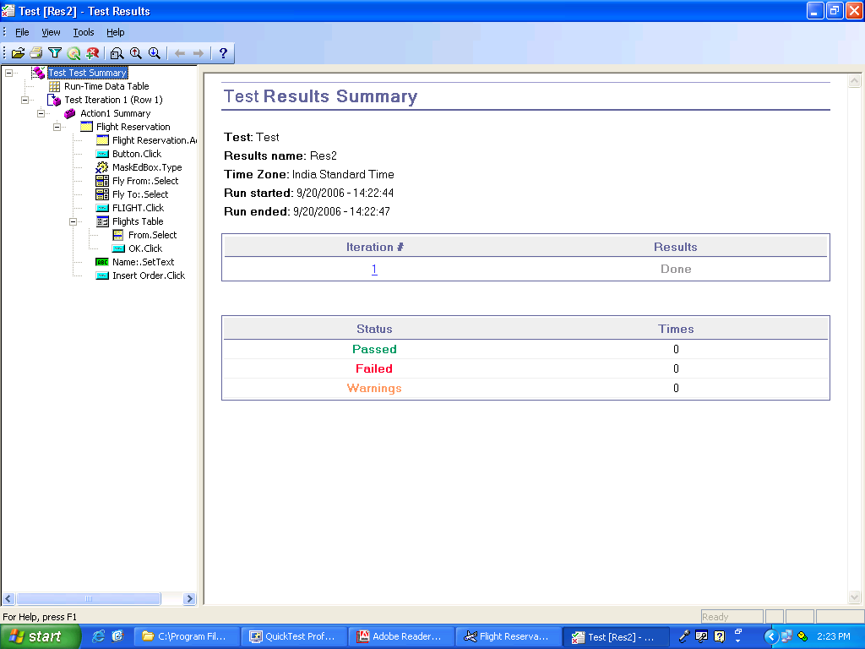
Test Result

Slide 17
Recording Modes
Recording Modes:
        Standard Recording Mode
        Low-Level Recording Mode

Slide 18
Recording Modes
Standard Recording Mode
records the objects in your application and the operations performed on them.
Low-Level Recording Mode
records mouse clicks and keyboard input with the exact x- and y-coordinates
Note:
By default, QuickTest records in the Standard Recording Mode

